Slide 1

IBM Capstone Project
Battle of the Neighbourhoods

Slide 2
Background
Options for investing into a restaurant business in 3 of the key metros within South Africa being Cape Town, Johannesburg or Durban. These cities where chosen due to them biggest in South Africa for locals as well has being seen from overseas as top travel Destinations.
City | Average disposable salary | Monthly transport costs | Rent for a 1-bedroom apartment in the city centre | Basic utilities | Meal for two people at a restaurant
Johannesburg | R17 360 | R1 330 | R6 720 | R800 | R500
Cape Town | R18 300 | R425 | R11 170 | R550 | R600
Durban | R15 000 | R375 | R9 940 | R1 230 | R410
https://businesstech.co.za/news/lifestyle/366416/the-most-expensive-cities-in-south-africa-in-2020-pretoria-vs-joburg-vs-cape-town-vs-durban/

Slide 3
Data Sources & Tools
1. Web Articles
3. Foursquare
Title | Comment
Source | Internet
Extract method | Web scrape
Use | Review previous analysis to understand key business and tourism cities, disposable income etc.
Title | Comment
Source | www.foursquare.com
Extract method | Web scrape. Extract venue info for suburbs in city
Use | this data will be used to understand the different restaurants available in a specific area
2. Geolocator
4. Census data
Title | Comment
Source | github
Extract method | Create Function
Use | geocode the Suburbs
Title | Comment
Source | https://census2011.adrianfrith.com/place/798013
Extract method | Web scrape. Extract suburbs within city
Use | Extract the suburbs for under the main place
Title | Comment
Juypter notebook | https://jupyter.org/
Pandas | https://pandas.pydata.org/
Numpy | https://numpy.org/
IBM cloud services | https://cloud.ibm.com/login
Geo | https://pypi.org/project/geopy/
BeautifulSoup | https://pypi.org/project/beautifulsoup4/
Folium | https://github.com/python-visualization/folium
5. Tools and Modules

Slide 4
Methodology
Extract the location suburb data per main place and city
GEO Code the Subplaces
Explore the data, Visualize graphically and maps
Use FourSquare API to extract the Restaurant Types
Prep the data for Clustering Model
Use Elbow Method to determine Optimum k
Cluster the Subplaces based on Restaurants

Slide 5
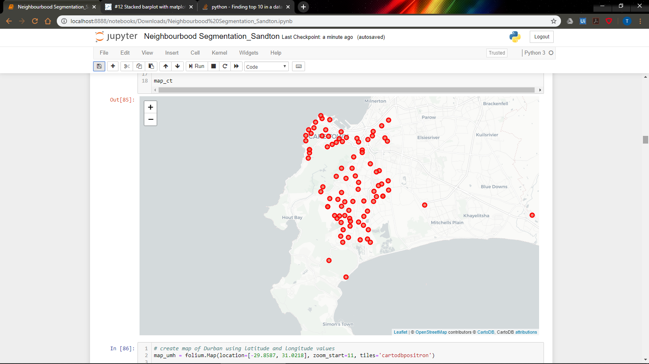
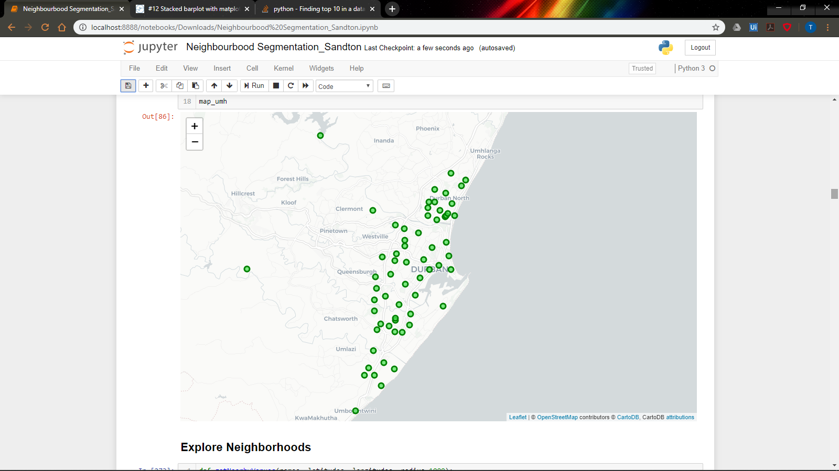
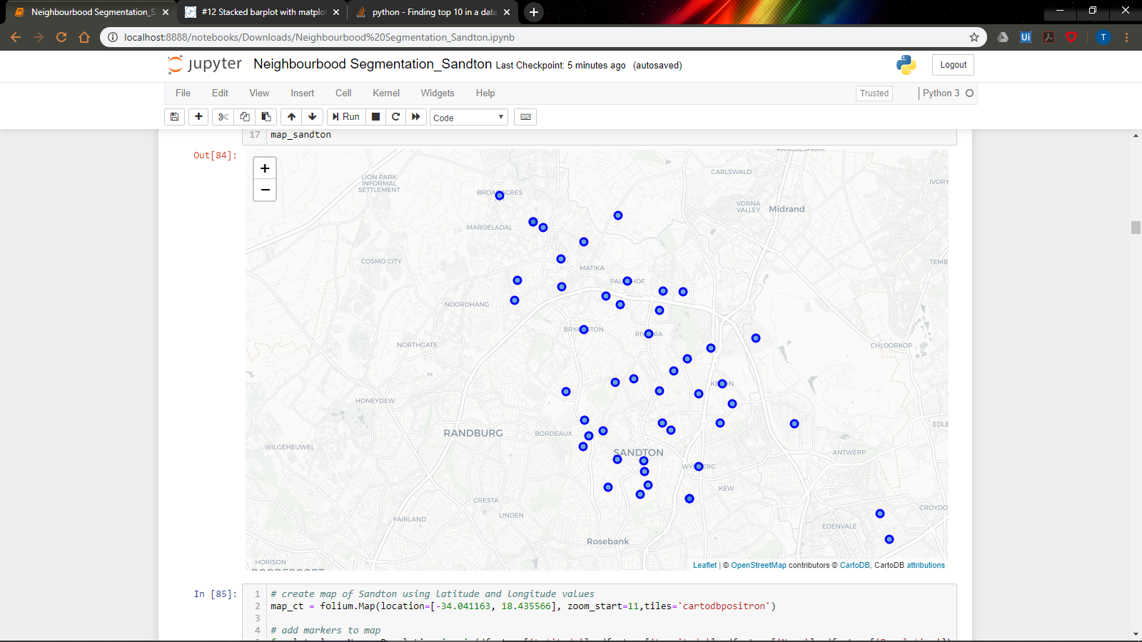
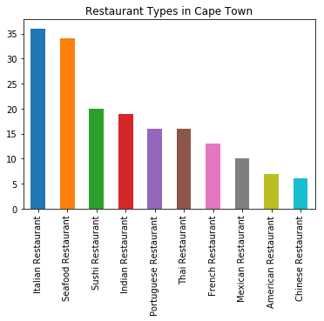
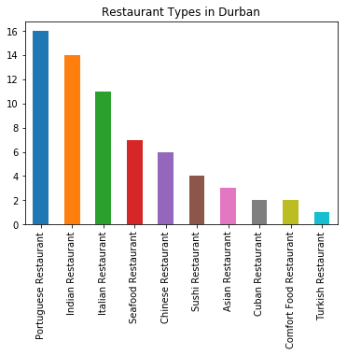
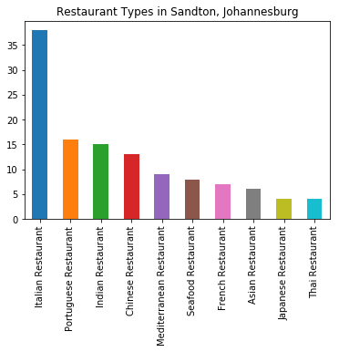
Results from Exploration
Cape Town
Durban
Sandton

Slide 6
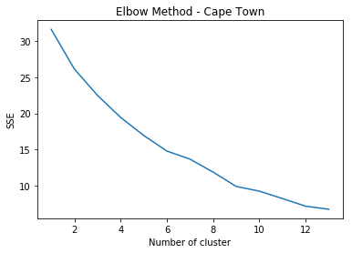
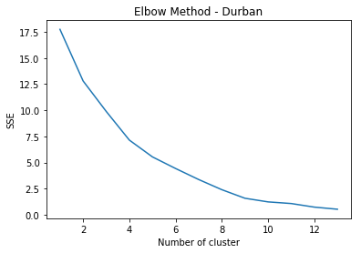
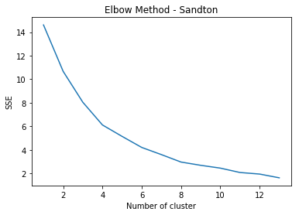
Elbow Joint results
Cape Town
Durban
Sandton
K=9
K=9
K=8

Slide 7
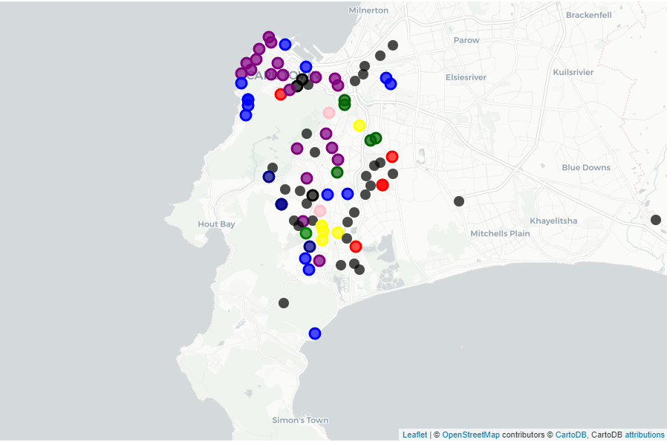
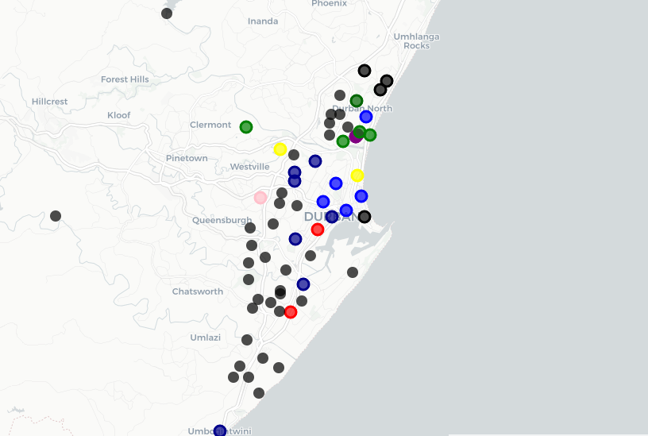
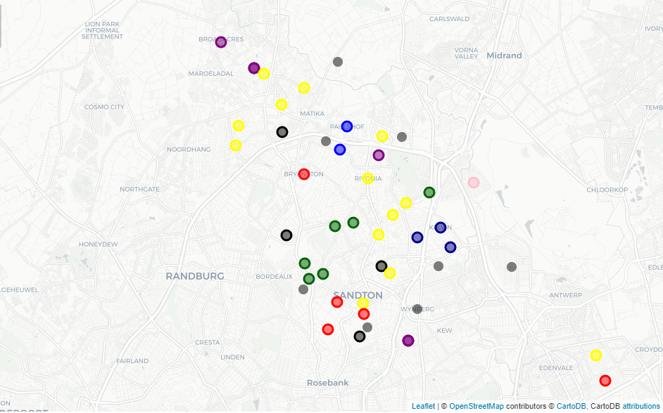
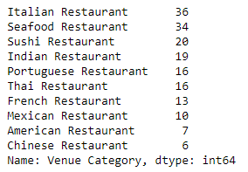
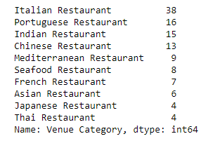
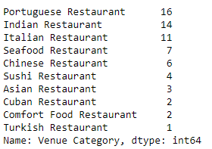
Clustering Results
Cape Town
Durban
Sandton

Slide 8
Reccomendation
The 3 key cities being Durban, Cape Town and Johannesburg are a good investment opportunity.
The market considers both tourist and business hubs, which will maximise both day time and night time occupancy rates.
The recommended choice of restaurant in Sandton and Durban would be of a Thai Theme. This is do to the high preference of food of Asian preference, observed by high demand of Indian, Asain themed restaurants. However Cape Town deviates slightly hence due to current presence Thai and limited Chinese offering.
The minimum occurrence of Thai restaurants in these towns and Chinese specifically in Cape Town presents ideal investment opportunities.

